Slide 1
Connected-Components Labeling
A Presentation by Craig Bester & Liam Pulles

Slide 2
Outline
Connected-Components Labeling is the task of finding and labeling the disjoint parts in a graph.
In computer graphics terms, this becomes the problem of finding distinct regions in a binary image.
This is often used to detect objects; regions of interest in an image.

Slide 3
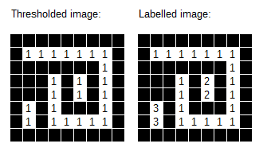
Process Example
Do not label the black pixels – part of the background.
After the connected-components labeling has completed, each element has a label unique to their group.
Image from: https://www.codeproject.com/Articles/825200/An-Implementation-Of-The-Connected-Component-Label

Slide 4
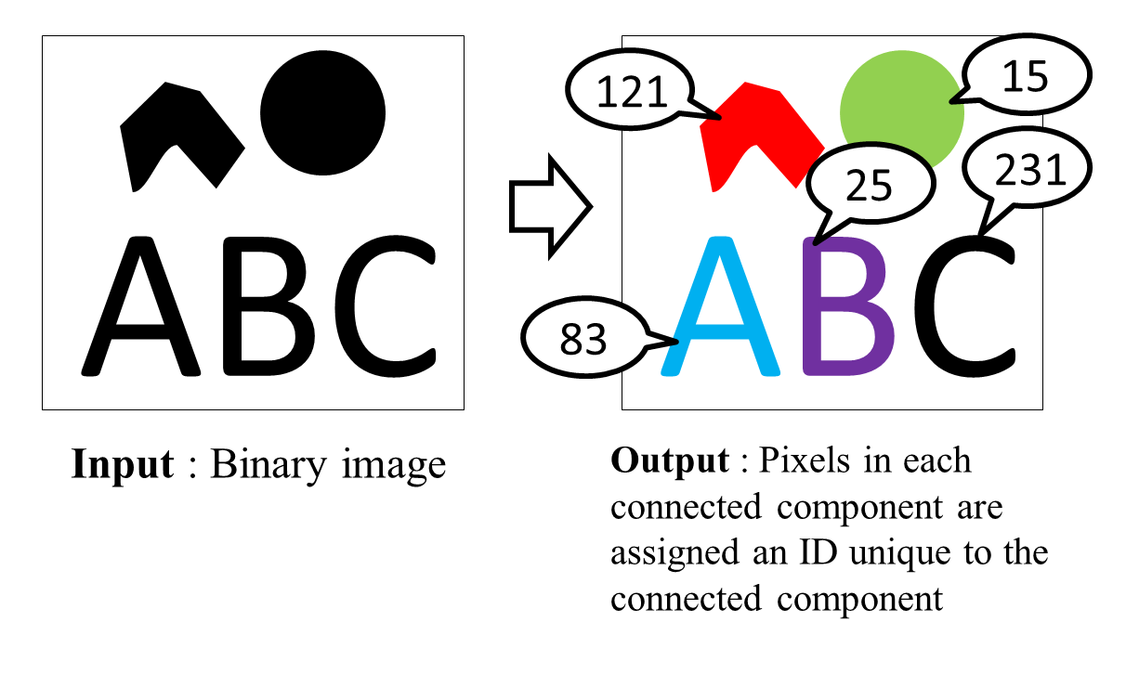
Example continued
To make the distinct regions easier to see, it is often desirable to colorize the output for demonstration purposes.
We do this in our program.
Image from: http://ito-lab.naist.jp/~n-sibata/cclarticle/index.xhtml

Slide 5
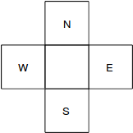
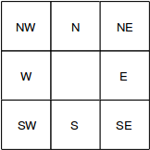
4-connect vs. 8-connect
There are different ways of regarding neighbors.
4-connect: Pixels are connected according to their N,E,S,W neighbors.
8-connect: Pixels are connected according to their N,NE,E,SE, S,SW,W,NW neighbors.
We use 8-connect for our implementations.

Slide 6

Forward Pass
Because it can be inefficient to check all 8 neighbors at each pixel, if we are going left-to-right and row-to-row, we can use a special mask.
Left: a forward pass mask for 8-connect.
Right: a forward pass mask for 4-connect.

Slide 7
Union-Find Overview
The Union-Find algorithm is an efficient way to keep track of which pixels belong to which regions or “sets”. We use some variation of Union-Find for all our implementations.
Initially, we assume all pixels are in their own distinct sets.
To put two pixels into the same set, we union the sets together.

Slide 8
Union-Find Overview
Once we are finished unioning pixels into sets, we can retrieve their group label by doing a set lookup – a find.
The find is not an immediate operation, and requires traversing a set of members to reach a descriptive “root” member.

Slide 9
Serial Implementation
For all our programs, we load an image and binarize it (by thresholding), then feed it into the algorithm.
In our serial algorithm, we do the following steps:
1) We create a Union-Find object with as many elements as we have pixels.
2) First pass – scan each pixel across the rows, top-to-bottom and merge each pixel with their neighbors’ labels from the forward scan mask (W, NW, N, NE).
3) Second pass – for each pixel, retrieve the final label from the Union-find object.
We colourise each pixel according to it’s label (thus giving independent regions distinct colors).

Slide 10
CUDA Implementation
In our CUDA program:
1) Copy the binarized image into a CUDA array and bind it to a surface –-- essentially a texture with write abilities. We use the surface because of its spatial locality speedup property when we do neighbor checking.
2) We initialize one thread for each pixel in 8x8 blocks.
3) [Initial] Each thread does the initial labeling for it’s pixel (setting it’s label to the thread id). Threads whose pixel has value 0 lay dormant for the rest of the process.

Slide 11
CUDA Implementation contd.
4) [Scan] Each thread looks at it’s forward pass neighbors. The thread’s label is then set to the minimum of it and it’s neighbors labels.
The label result of this will vary depending on how quickly individual threads can race to find the minimum, and set their own label (before other threads check it).
5) [Analysis] Each thread retrieves their current group label using the Union-Find propagation method.

Slide 12
CUDA Implementation contd.
6) Loop the following steps until no changes occur in the labels:
  I) [Link] Each thread analyses it’s forward pass neighbors . The thread updates its group label to the minimum of its current label and neighbors’ labels.
  II) [Relabel] Each thread again sets their label to their group label.
  These two steps will join some, if not all of the groups together.

Slide 13
CUDA Implementation contd.
  III) [Rescan] Each thread find the minimum of its forward pass neighbors labels. If the minimum of these neighbors’ labels is not equal to the thread’s own label, mark that we need to do another loop.
  We stop looping when all the pixels have neighbors with the same label.
7) Copy the image from the GPU back to the host and attain our result!

Slide 14
CUDA Implementation notes
Although thread contention is likely to occur when checking and setting neighbors, thread interleaving hides this latency.
We also implemented a version which makes use of global memory (which is slightly faster).
We did not make use of shared memory, as memory accesses are not block-local (threads can directly set their “root” nodes, potentially far away.)
We also did not make use of constant memory, as all of the data changes quite rapidly, the data is potentially too big, and the amount of data we process varies in size greatly.

Slide 15
MPI Implementation
Block-Row
Decomposition
In our MPI program for p processes:
0) Load the image on the master process (rank 0).
1) Use block-row distribution:
  Split the binarized image into n/p sized blocks (n is #pixels).
  Distribute the rows with MPI_Scatterv().
Block 1
Block 2
Block 3
2) Each process now performs serial labeling algorithm on its block, finding and labeling the local regions.
3) The blocks are sent back to the master process with MPI_Gatherv().
4) The master process merges the regions along the boundaries between the blocks (first pass) and then relabels the whole image (second pass).

Slide 16
MPI Implementation notes
Merge
Although it is possible to perform the merging of the regions in parallel using a binary tree like method, it would entail additional communication costs and redundant work. The relatively small sizes of the images means the startup cost of communicating would outweigh any advantage of doing the merge in parallel. Also, the master process always has to do the final merge and global relabeling, making parallel relabeling redundant.
Block 1
Block 2
Block 3
We do more than two passes on the image, however:
  I) The first two passes are done in parallel (for the local blocks).
  II) The scan step of the final merge only requires the boundary rows of the chunks. There are p – 1 boundaries so this step is fast.

Slide 17
Demo...

Slide 18


Example program execution
./ccl_unionfind -f f0001.bmp

Slide 19
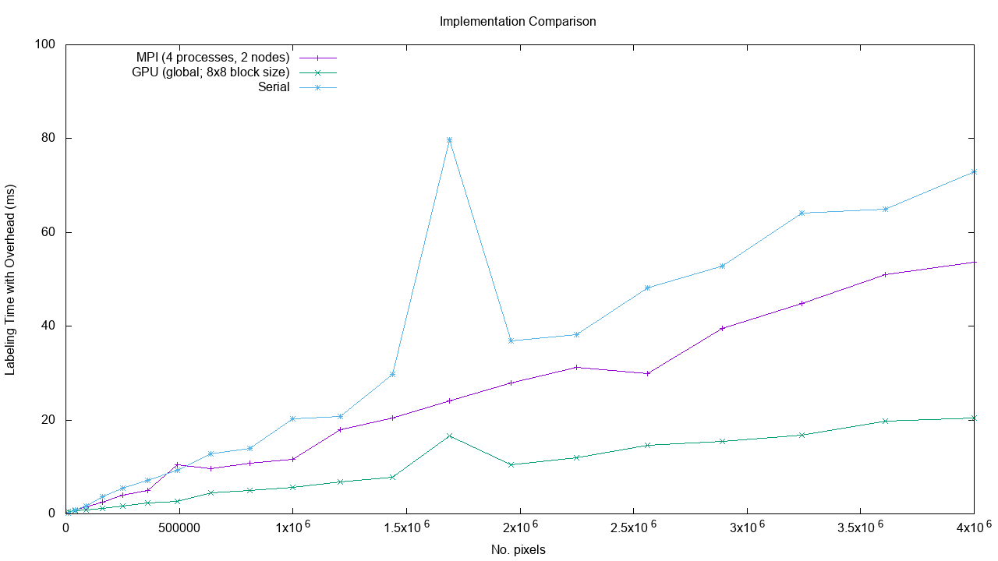
Time Comparison

Slide 20
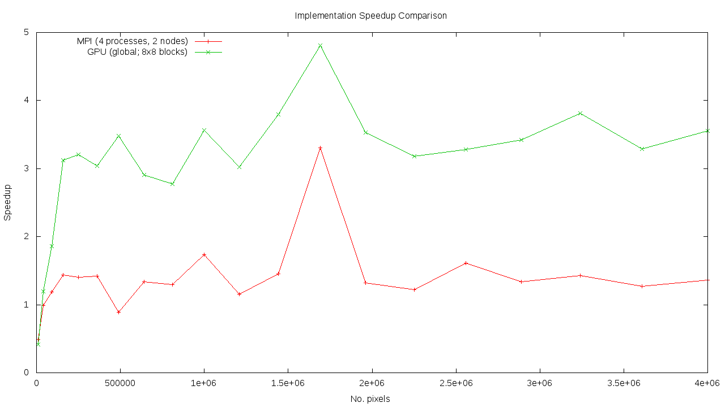
Speedup Comparison

Slide 21
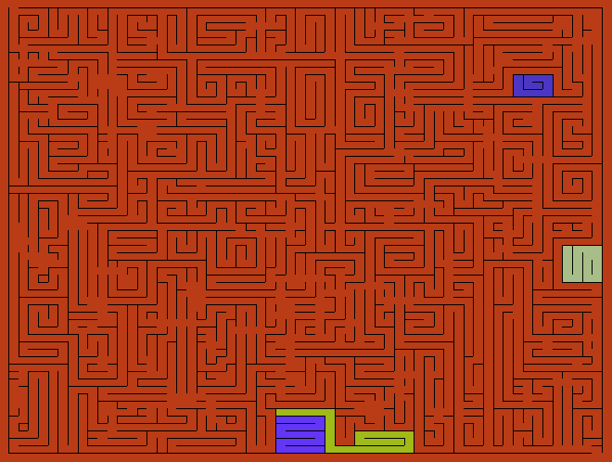
Speedup example
Speedup for the various algorithms on the hard-maze challenge image:
Implementation | Time (ms) | Speedup
Serial | 5.27 | 1
CUDA (surface) | 2.42 | 2.1
CUDA (global) | 2.04 | 2.5
MPI | 6.09 | 0.8

